Slide 1
Disclaimer: The opinions expressed by
Dr. Anne Sinatra during this presentation are her own and do not represent the position of the U.S. Government, the U.S.
Department of Defense, or the U.S. Army.
The 2020 Research Psychologist’s Guide to GIFT
Anne M. Sinatra, Ph.D.
US Army Combat Capabilities Development Command (CCDC) - Soldier Center - Simulation and Training Technology Center
28 May 2020 – GIFTSym8

Slide 2
Outline
Outline of Presentation
How to use GIFT for Research
Important Research Decisions in GIFT
Running an Experiment in GIFT
Recommendations for additional relevant features in GIFT

Slide 3
DON’T PANIC
“It is said that despite its many glaring (and occasionally fatal) inaccuracies, the Hitchhiker’s Guide to the Galaxy itself has outsold the Encyclopedia Galactica because it is slightly cheaper, and because it has the words ‘Don’t Panic’ in large friendly letters on the cover” (Adams, 1979).
The 2020 Research Psychologist’s Guide to GIFT
This guide documents lessons learned, approaches, and suggestions for conducting research using the Generalized Intelligent Framework for Tutoring (GIFT).
Previous Research Psychologist’s Guides: Sinatra, 2014, 2016, 2018
Instructor’s Guides: Sinatra, 2015, 2019

Slide 4
DON’T PANIC
The Research Psychologist’s Guide to GIFT
GIFT can seem overwhelming at first
The course authoring and survey authoring tools have been designed with usability in mind
There are many resources to explain the course building process
GIFT has a number of features that make it a good tool to use to run experiments

Slide 5
Why should a Research Psychologist use GIFT?
Advantages of Using GIFT in Psychology Research
Does not require knowledge of computer science or computer programming
Provides an automated experiment process; do not need multiple research assistants to run an experiment
Has a Cloud version which can be used for a seamless online study which does not require anything to be downloaded to the participant’s computer
Course and survey authoring tools have many features
Data can be exported to be viewed in Excel and/or SPSS

Slide 6
CREATING AN EXPERIMENT IN GIFT
Creating a Course/Using the Course Authoring Tool
Slide Show Object vs. PowerPoint Object
Survey vs. Question Bank

Slide 7
CREATING A COURSE
The first step in creating an experiment is to create a GIFT course.
The course authoring tool has a drag and drop interface.
Course Objects from the left side of the screen are dragged to the right side of the screen, which is called the Courseflow.
Many different types of Course Objects can be utilized within the course.
Surveys and Questionnaires can also be authored.

Slide 8
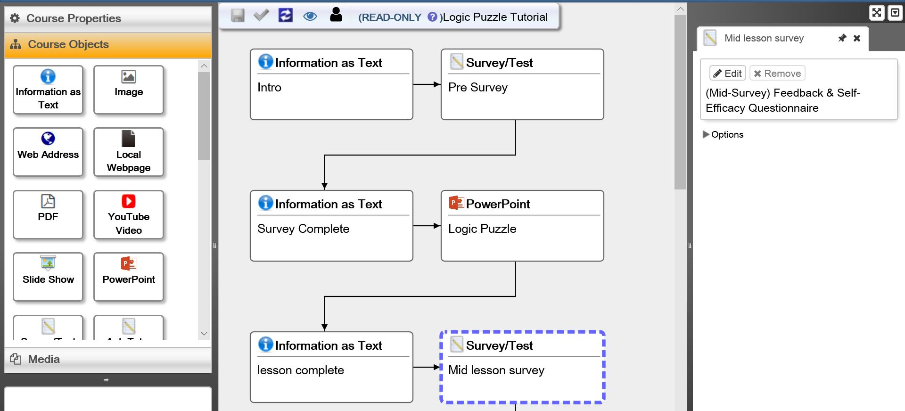
CREATING A COURSE
GIFT Course Authoring Tool
Course Objects are on the left; The Courseflow in the center; Selected item properties are on the right.

Slide 9
CREATING A COURSE
Relevant Course Objects Include:
PDFs
Surveys
Question Banks
PowerPoints
Slide Shows
Authored Branching
Local Webpage
Web Address

Slide 10
PowerPoint Object VS SLIDE SHOW OBJECT
PowerPoint Object
Opens PowerPoint on the participant’s computer
Requires that PowerPoint be installed on the participant’s computer
GIFT can monitor how long participants spend on each slide
Slide Show Object
Starts as an uploaded PowerPoint show file (.pps)
GIFT creates a series of images that can be navigated through by the participant
Does not require PowerPoint to be installed on the participant’s computer
Macros, Videos, and Animations cannot be used

Slide 11
POWERPOINT OBJECT VS SLIDE SHOW OBJECT
(Sinatra, 2018)
Requirement | PowerPoint Object | Slide Show Object
PowerPoint with or without images and no interactions |  | X
Videos or Audio in the PowerPoint Presentation | X
Visual Basic for Applications or Macros are used | X
Online presentation of materials on participant’s own computer |  | X
Assessment or time spent on slides is needed | X

Slide 12
Survey vs. Question Bank
Survey Object
Presents questions in a specific order
Always presents all of the authored questions
Multiple types (non actionable and actionable)
Question Bank Object
A bank of questions for the entire GIFT Course
GIFT Course Concepts need to be setup
Selects a specific researcher entered number of questions to show the participants
Questions are randomized
Not all questions are shown

Slide 13
Survey vs. Question Bank
Survey/Test Object vs. Question Bank Object
Requirement | Survey/Test Object | Question Bank Object
Present questions in a random order |  | X
Present questions that are associated with concepts |  | X
Collecting demographics information | X
Using a questionnaire or measure that requires a specific order of presentation | X
Not all generated questions are required to be answered |  | X
Using an assessment that requires all questions to be answered and to be shown in a specific order | X
Questions will be reused in Adaptive Course Flow object |  | X

Slide 14
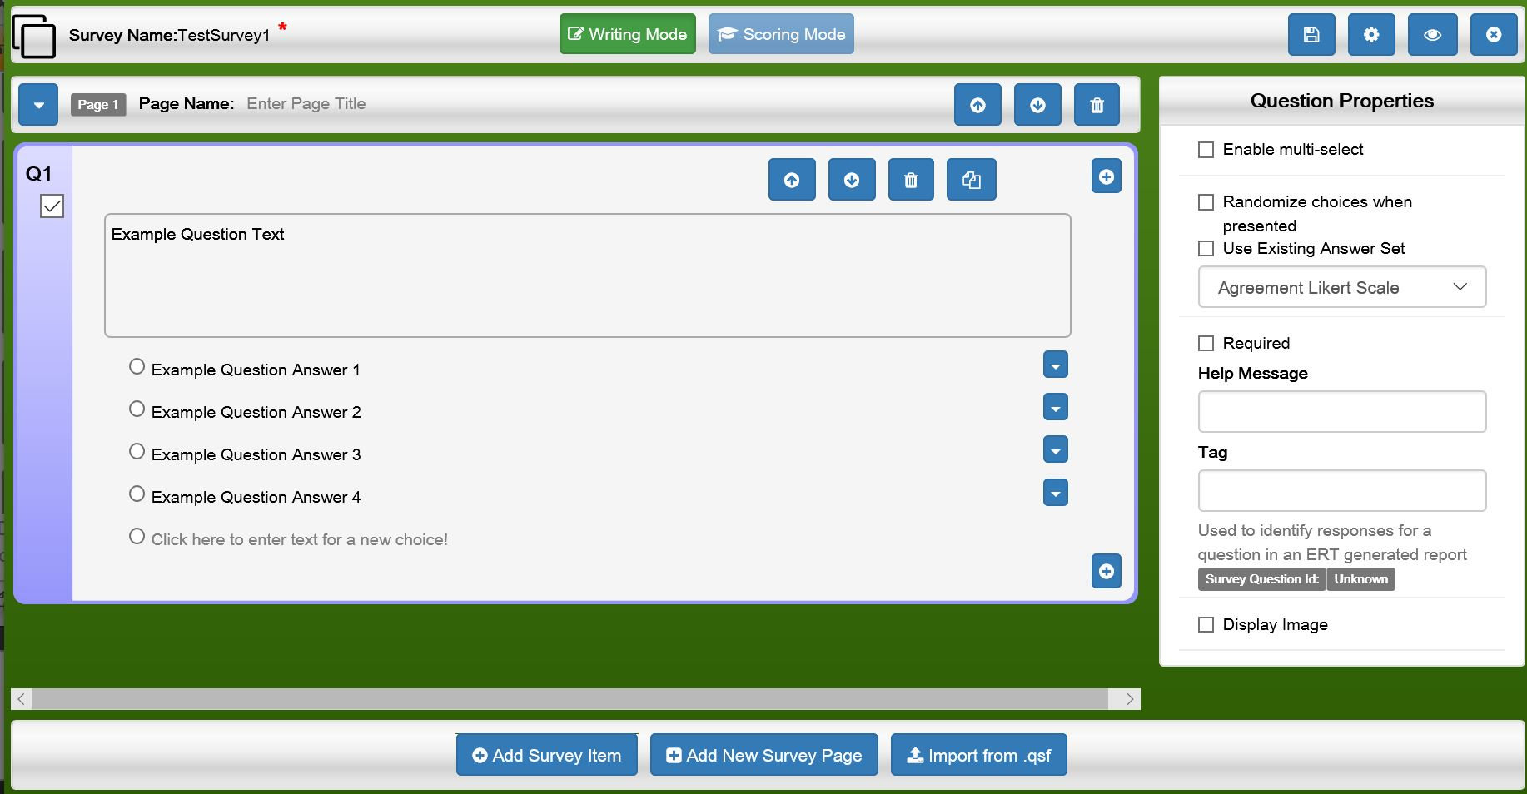
Survey vs. Question Bank
Survey Authoring Interface

Slide 15
IMPORTANT DECISIONS
Cloud vs. Desktop
Published Experiment vs. GIFT Course
Experiment Courseflow and Authored Branching

Slide 16
CLOUD VS. DESKTOP
GIFTCloud
Does not require GIFT to be installed
Depending on the approach it may or may not require a GIFT account
If a training application is used, a gateway module will be temporarily downloaded to the computer
If not using a training application it is an online seamless experience
Desktop
Requires an installation of GIFT
Logs are written to the computer itself
Supports Virtual Battlespace 3
Supports sensors

Slide 17
CLOUD VS. DESKtoP
Requirement | Cloud | Desktop
Easy Access to Saved Logs regardless of login method |  | X
Easily Interacts with External Training Applications |  | X
Only uses Survey Based responses and images/text for content | X
Uses sensors |  | X
Participants can engage with the experiment at any day or time on their own computers | X
(Sinatra, 2018)

Slide 18
PUBLISHED Experiment VS. GIFt COURSE
Published Experiment
Participant is provided a link to the experiment
Participant number or name is not included in the data
Need to include a question asking for the participant number (which needs to be provided to the participant separately)
Updated data extraction tools
GIFT Course
Requires a participant login
On the Cloud version logs cannot be manually downloaded by the researcher
Participation is linked directly to the participant
Data extraction tools have not recently been updated

Slide 19
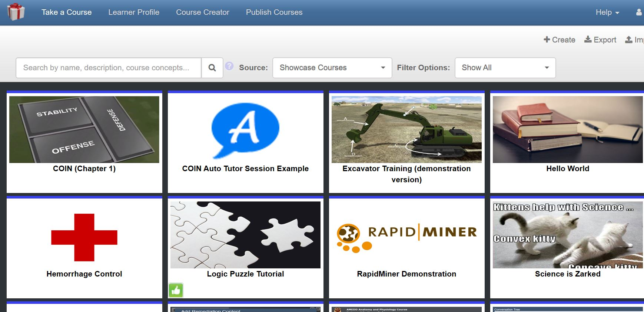
PUBLISHED Experiment VS. GIFt COURSE
GIFT Course Interface
Published Course Interface
GIFT Login Interface

Slide 20
EXPERIMENT COURSEFLOW AND AUTHORED BRANCHING
TRADITIONAL APPROACH
Create three versions of the course for a three condition experiment
Copy the original GIFT Course and change the object that is manipulated
When data is exported there are three clear sets of data that can later be merged
AUTHORED BRANCHING
Create one version of the GIFT Course
Different approaches to assigning participants to a condition
Insert the Authored Branch course object for the object that is the experimental manipulation
Create each of the unique paths for the condition, and indicate not to end the course
GIFT Course will resume after the experimental manipulation
Careful attention needs to be paid to the data output so that the condition is clear

Slide 21
EXPERIMENT COURSEFLOW AND AUTHORED BRANCHING

Slide 22
EXPERIMENT COURSEFLOW AND AUTHORED BRANCHING
Authored Branching Object and the different participant distributions

Slide 23
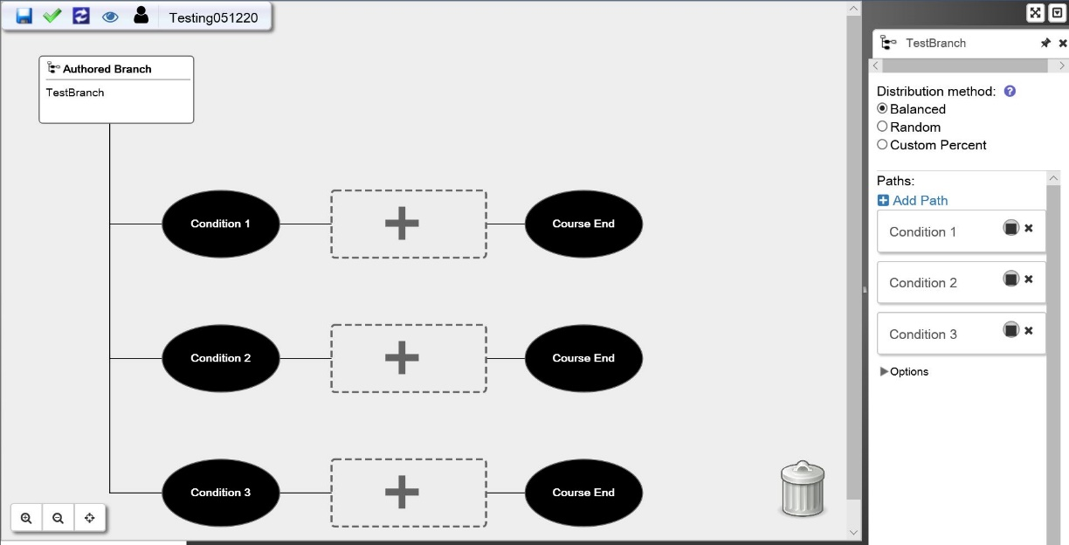
EXPERIMENT COURSEFLOW AND AUTHORED BRANCHING
Authored Branching Object and the paths that are created

Slide 24
RUNNING YOUR EXPERIMENT IN GIFT
Discussing the “Publish Experiment” approach
Create your Course using the Course Authoring Tool
Click on Publish Experiment
Select the Course from the interface and click “Publish Course”
You will be provided with a URL to provide participants
There is an interface to Stop and Start the experiment, and to extract the data
Survey data can be extracted and merged so that each line has a separate participant, and the questions are at the top of each column
Data can be imported into Excel and SPSS

Slide 25
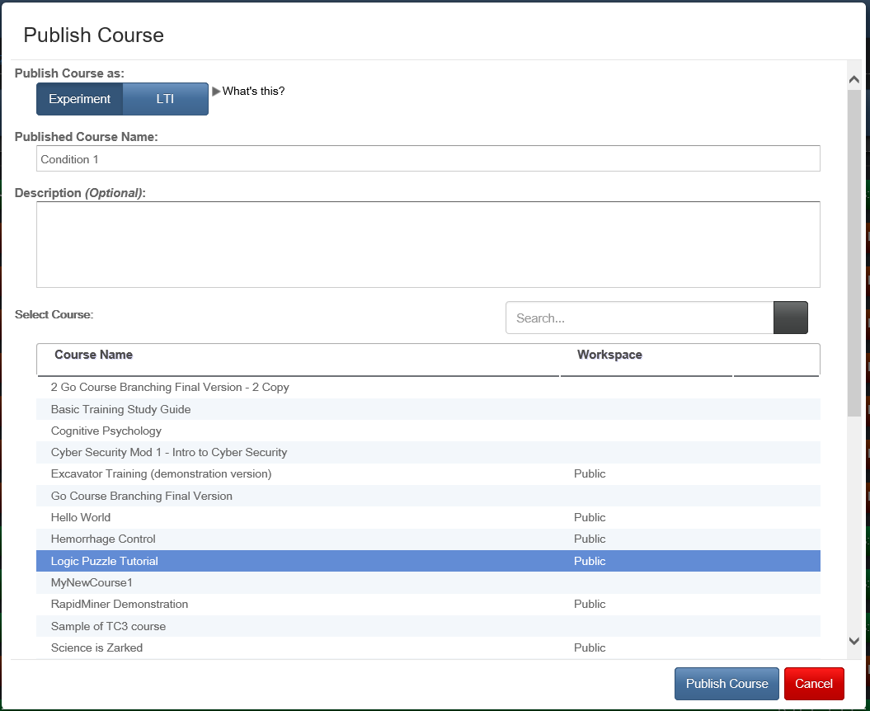
RUNNING YOUR EXPERIMENT IN GIFT
Publishing a Course

Slide 26
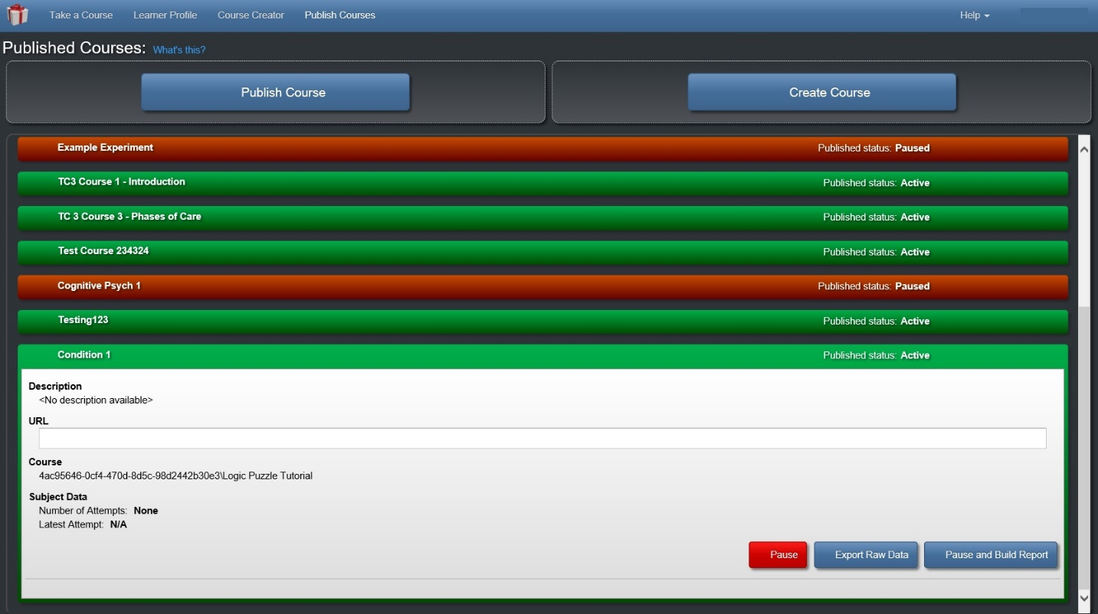
RUNNING YOUR EXPERIMENT IN GIFT
Published Course Interface/Extracting Data

Slide 27
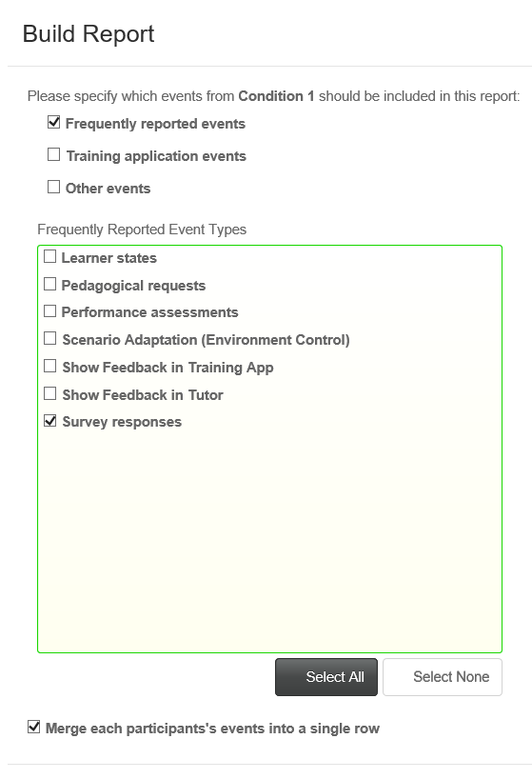
RUNNING your EXPERIMENT IN GIFT
Extracting Data

Slide 28
Updates to GIFT that are Relevant to Experimenters
The full text of the question is now exported in the question name during survey data extraction.
There is the ability to create an authored branch and keep your entire experiment within one course.
There is now the ability to edit a published experiment.

Slide 29
RECOMMENDATIONS/POTENTIAL IMPROVEMENTS
Updating Data Output methods for GIFT Courses (not published courses)
Currently need to ask for Cloud based logs
Need to use prior tools in GIFT which have not been updated
Template for Experiment Course in GIFT
Public Course
Create Authored Branching
Create Surveys
Ability to Run the Course and Export Data
Can be a starting point for creating new experiments

Slide 30
CONCLUSIONS/LOOKING AHEAD
GIFT is a powerful tool for researchers
GIFT can be used to answer traditional Psychology research questions
As GIFT continues to develop new Team Tutoring functionality is being added
Team Tutoring research questions can be addressed in the future using GIFT

Slide 31
Acknowledgements
The research described herein has been sponsored by the U.S. Army Combat Capabilities Development Command (CCDC) Soldier Center (SC). The statements and opinions expressed in this presentation do not necessarily reflect the position or the policy of the United States Government, and no official endorsement should be inferred. Additionally, the author would like to acknowledge and thank the entire CCDC SC Adaptive Training team, who have all been instrumental in the design and development of GIFT and the GIFT authoring tools.

Slide 32
Questions
Questions?

Slide 33
REFERENCES
Adams, D. (1979). The hitchhiker’s guide to the galaxy. New York: Pocket Books.
Sinatra, A. M. (2014). The research psychologist’s guide to GIFT. In Proceedings of the 2nd Annual GIFT Users Symposium (pp. 85-92).
Sinatra, A. M. (2015, August). The Instructor’s Guide to GIFT: Recommendations for using GIFT In and Out of the Classroom. In Generalized Intelligent Framework for Tutoring (GIFT) Users Symposium (GIFTSym3) (p. 149).
Sinatra, A. M. (2016). The Updated Research Psychologist’s Guide to GIFT. In Generalized Intelligent Framework for Tutoring (GIFT) Users Symposium (GIFTSym4) (p. 135).
Sinatra, A. M. (2018, May). The 2018 Research Psychologist’s Guide to GIFT. In Proceedings of the Sixth Annual GIFT Users Symposium (Vol. 6, p. 259). US Army Research Laboratory.
Sinatra, A. M. (2019, May). The 2019 Instructor’s Guide to GIFT. In Proceedings of the 7th Annual GIFT Users Symposium (p. 19). US Army Combat Capabilities Development Command–Soldier Center.

