Slide 1
Intelligent Exercise Control: Integrating GIFT and
Battle Space Visualization
Benjamin Goldberg, Ph.D. and Michael Hoffman
Senior Scientist/GIFTsym Chair
DISTRIBUTION A: APPROVED FOR PUBLIC RELEASE
CCDC-SC, Simulation and Training Technology Center
16 May 2019 – GIFTSym7 – Day 1
12 MAR 2019

Slide 2
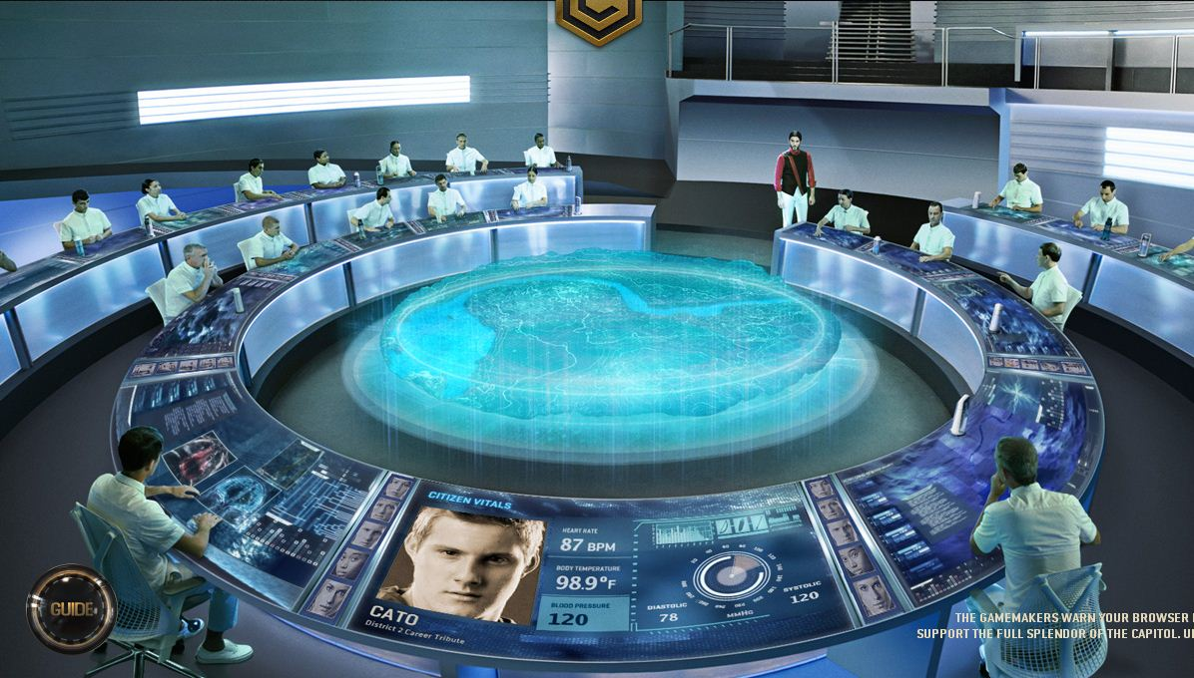

Slide 3
Agenda
Training Management Technology Overview
Battle Space Visualization via the Augmented Reality Sandtable (ARES)
GIFT Learning Effect Chain
GameMaster Concept for Intelligent Exercise Control
Training Facilitators and Observer Controllers (OC)
Adaptive Instructional Supports via GIFT to Support/Supplement OC Workload
GIFT Modifications
Human on the Learning-Effect-Chain Loop
Game Master Interface
Link to Persistent Modeling and Recommendation Engines
Integration with the Total Learning Architecture

Slide 4
Battle Space Visualization via ARES

Slide 5
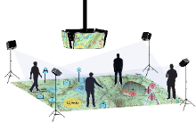
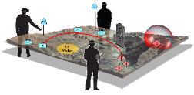
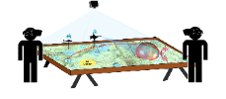
ARES Architecture Overview
Sample Data Inputs
Application Programming Interface
Interoperability¹
Head Mounted
Augmented Reality
Virtual Reality
Mixed Reality
Projected
Pico
Table
Floor
Extensible
Personal Computer
Mobile
Desktop
Laptop
Terrain
Imagery (Google Maps, JPEG, TIFF, etc.)
Topographic (CADRG, GeoPDF, etc.)
Elevation (DTED, DEM, GeoTIFF, etc.)
Services
Intelligent Tutors (GIFT, etc.)
Models (Chem-Bio Plume, Route, Weapon Range, Cyber, etc.)
Live Unit Location (JCB-P, etc.)
Training Simulator (VBS, OneSAF, etc.)
Software Development Kit
Interoperable
¹ Distributed Interactive Simulation (DIS) v7 compliant
ARES
Exports
Terrain Files (GeoTIFF, OTF, Unity, etc.)
Scenario Data² (Tactical Graphics & Symbols)
² Military Scenario Definition Language (MSDL) compliant
Sample Interaction Methods: Tangible User Interface, Game Controller, Tokens, Gesture, Voice, Mouse & Keyboard, Stylus
Notes:
An open, modular architecture that is extensible, interoperable and platform indepedent supporting 3rd party development in a community of practice.

Slide 6
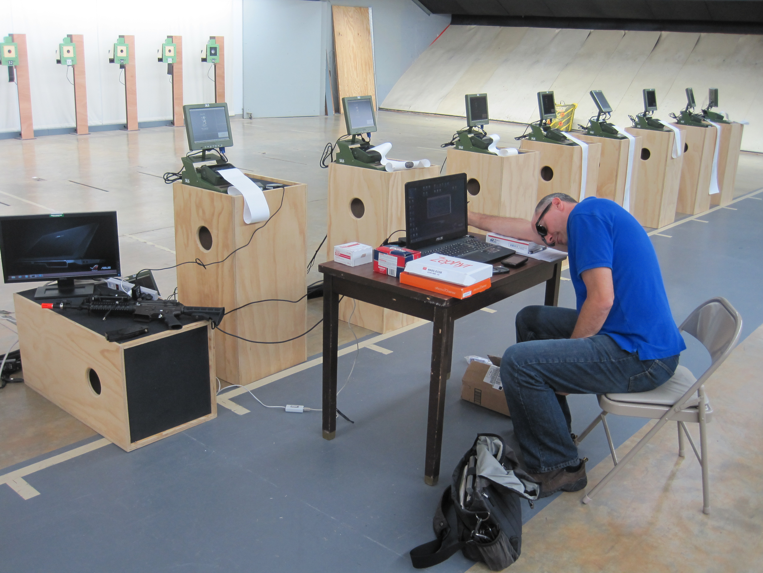

Slide 7
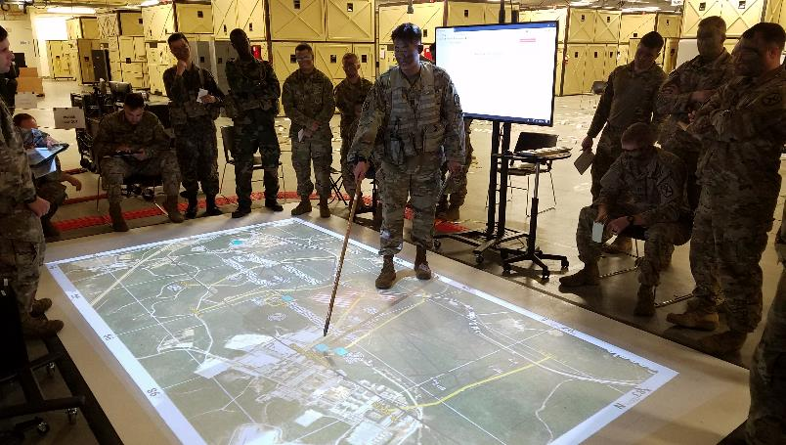
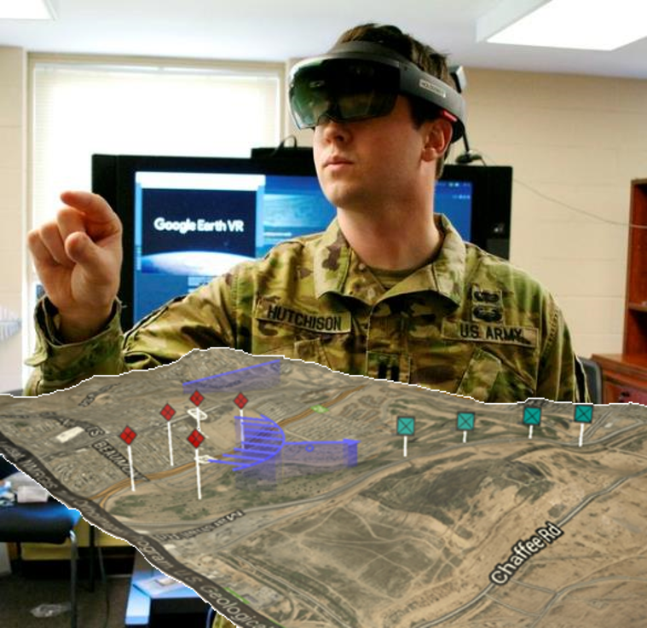
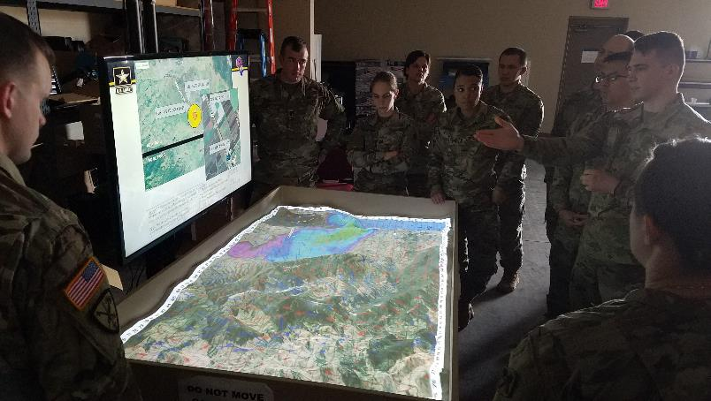
Multiple Modalities
Left: Floor projection @ Ft Benning
Bottom Left: Sand table @ Ft Leonard Wood
Bottom Right: Mixed reality @ West Point
Supports distributed collaboration amongst all modes

Slide 8
Adaptive Training and Intelligent Tutoring via GIFT

Slide 9
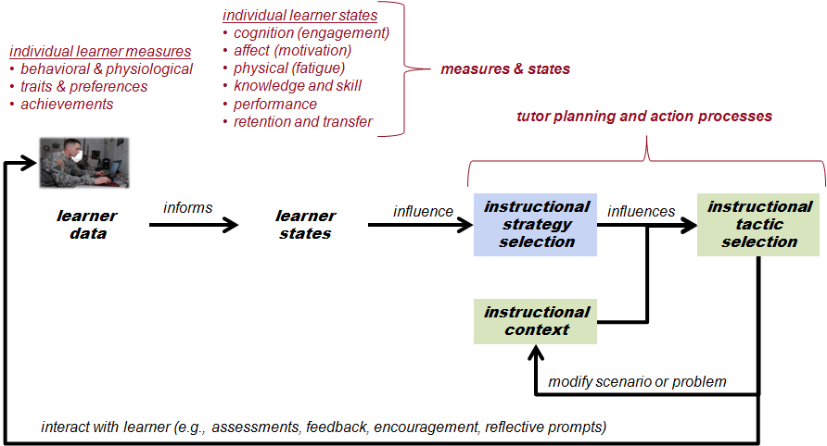
(Sottilare et al., 2013)

Slide 10
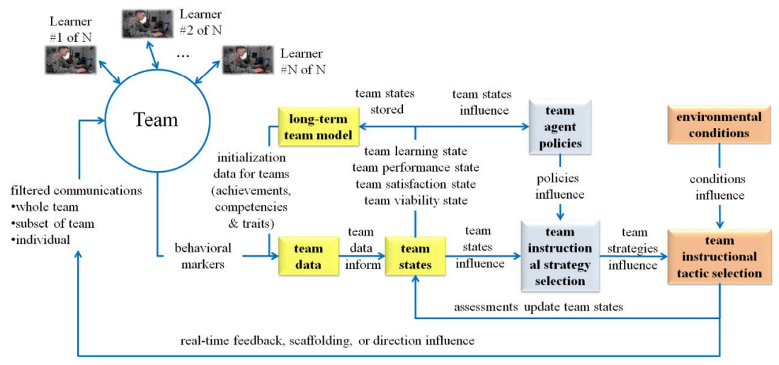
Adaptive Learning Effect Chain… for teams
(Sottilare et al., 2018)
Notes:
Automated Team Measurement/Assessment/Diagnosis across LVC and Cognitive/Affective/Psychomotor Dimensions
Task Work
Team Work
Individualized Measures and Assessment
Desired Library of Generalizable Measures
Communication and Natural Language Dependencies
Epistemic Network Analyses (Shaffer, Univ. of Wisconsin)
Intelligent Team Coaching and After Action Review
Adaptive Sequencing and Resource/Content Management
Mobile/AR Interfacing

Slide 11
Game Master Concept for Intelligent Exercise Control

Slide 14
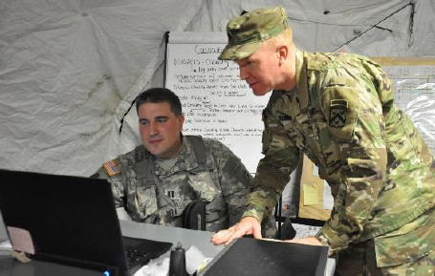
Observer Controller/Trainer
Subject Matter Experts on doctrine and in their specific warfighting function
Mission Command
Movement and Maneuver
Fires
Sustainment
Protection
Intelligence
Play a critical role in providing feedback to the unit, informally, through everyday interactions and, formally, through mid and final after action reviews (AARs)
These events give the training audience actions to consider for sustainment and improvement

Slide 15
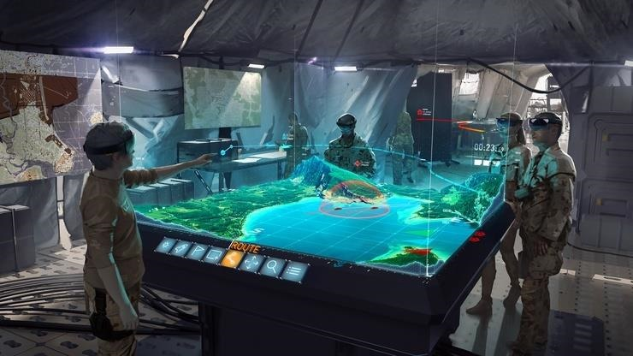
Adaptive Learning Engine via GIFT
(Real-time Assessment)
EKG, GSR, Breathing, Eye Tracking etc.
DIS/HLA/GPS/COMMS
(Assessment)
Workload, Affect, Cognitive State
Gateway Module
(Interop Configurations)
Human-Centered
Measures
(Spotlite?)
Stealth Assessments
(TTPs)
DIS/HLA/GPS/COMMS
(Visualization)
Team States
(Task Work/Team Work)
Strategy Options
DIS/HLA/GPS/COMMS
Trainee A
Biosensors
Game Master
Battlefield Visualization UI
Human
Observer Controller
GIFT Widget (Assessment)
Training Environment
(STE, Live Instrumented, VBS)
GIFT Widget (Strategy Handler)
Strategy Injects
(Feedback/Adaptations)
Trainee B
Trainee C
Trainee D

Slide 16
Total Learning Architecture (TLA)
CaSS
Universal Learner Record
Recommender Engine
Adaptive Learning Engine (GIFT)
Domain Modeling
Assessment
SAM T (Fire Team)
VBS 3 (Squad)
TALK ON (Tank PLT)
CGSC (Com Gen Staff School)
Individual Task Work
Team Cohesion
Intelligent Adaptive Training
Coaching/Feedback
USMA Convoy/Cyber (PLT)
Competency (SPM)
Reinforcement Learning
Team Task Work
Team Coord
Adaptations/MSELs (Manage Complexity)
Camp Shelby (SQD)
Team Marksmanship
FO Smart (Indirect Fires)
Real-time
AAR
Team Comms
Cyber Injects (CobWebs)
Scenario Selection (Targeted Objs)
Individual/Team Differences
Affect/
Workload
JRTC/CTC-IS
(Mission Command)
Others?
(ASU, Army U, MCoE)
Enabling Tech
Unit A
Biosensors
Data Gateway
Synthetic Training Environment
(IVAS, S/SVT, RCVT, OWT, CTC-IS, etc.)
Comms Capture/Parsing (NLP)
Unit B
Sensors (State Classifiers)
(MASTR-E?)
Data Parser/Manager
Unit C
Unit D
Battle Space Visualization (ARES)
Multi-Modal Interaction
(Constructive vs. 3D Interfacing)
Gesture Control
Physio Model Visualization??
AAR Interfacing/Replay
(CTC-IS Use Case)
SMASH Library
(Sniper at x,y,z)(NLP induced)
ALE Assessment
Widget
ALE Strategy
Handler
Cyber Threat Attribution Models
(COBWEBS)
Scenario Run-Time Visualization
(Sand, Floor, AR, VR, etc)
Data Layering
(Echelon, Fog of War, etc.)

Slide 17
GIFT Modifications

Slide 18
Adding a human (OC) to the Learning effect chain

Slide 19
Adding a human (OC) to the Collective Learning effect chain
(Sottilare et al., 2018)
Notes:
Automated Team Measurement/Assessment/Diagnosis across LVC and Cognitive/Affective/Psychomotor Dimensions
Task Work
Team Work
Individualized Measures and Assessment
Desired Library of Generalizable Measures
Communication and Natural Language Dependencies
Epistemic Network Analyses (Shaffer, Univ. of Wisconsin)
Intelligent Team Coaching and After Action Review
Adaptive Sequencing and Resource/Content Management
Mobile/AR Interfacing

Slide 20
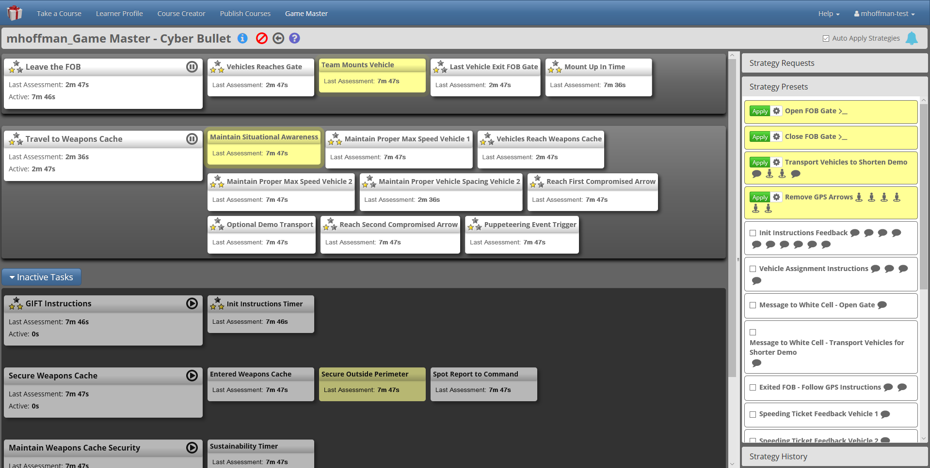
Game master interface (Alpha)

Slide 21
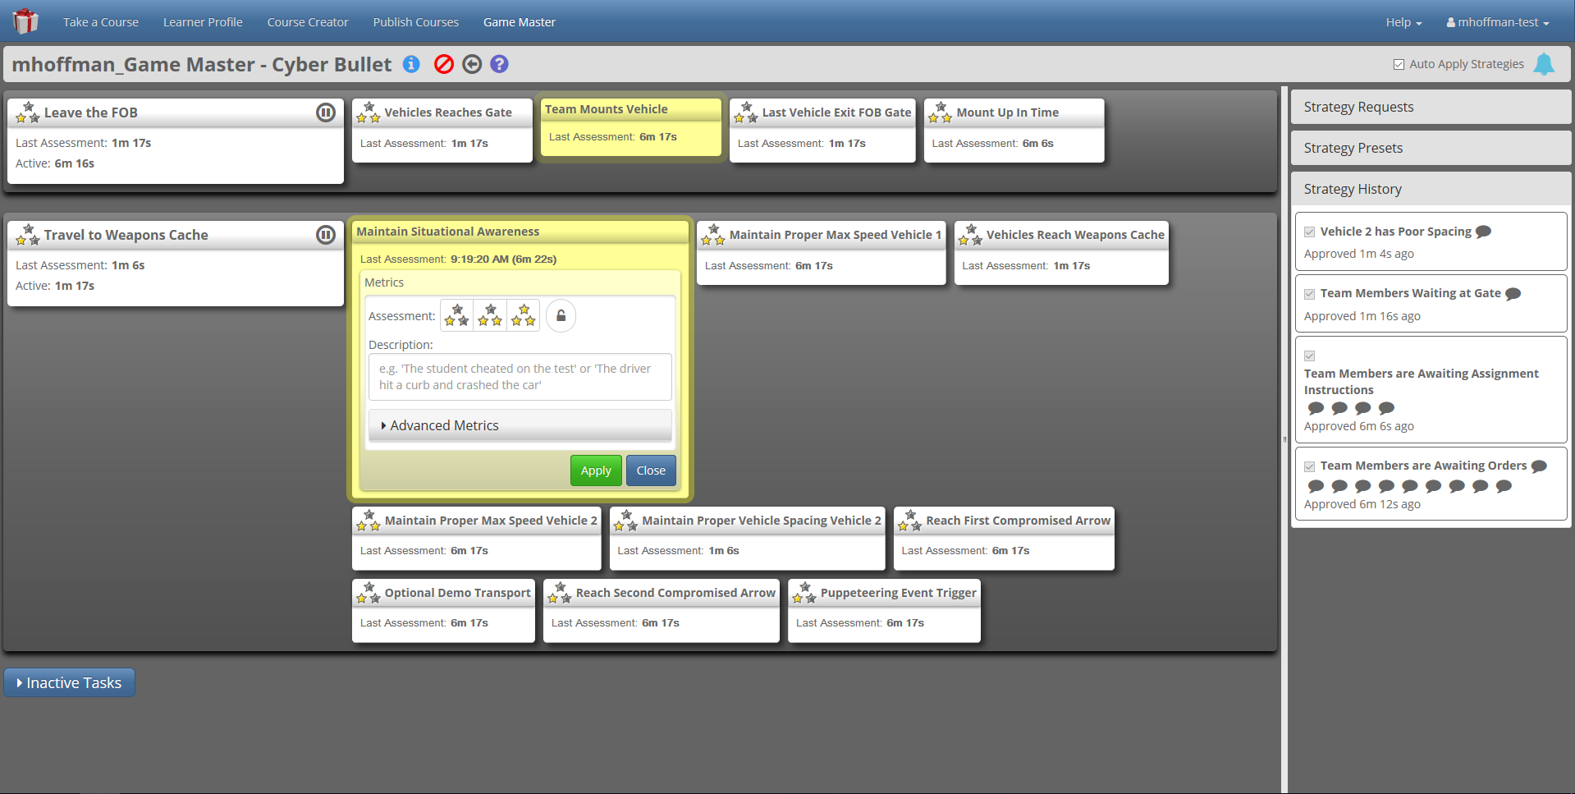
Game master interface (Alpha)

Slide 22
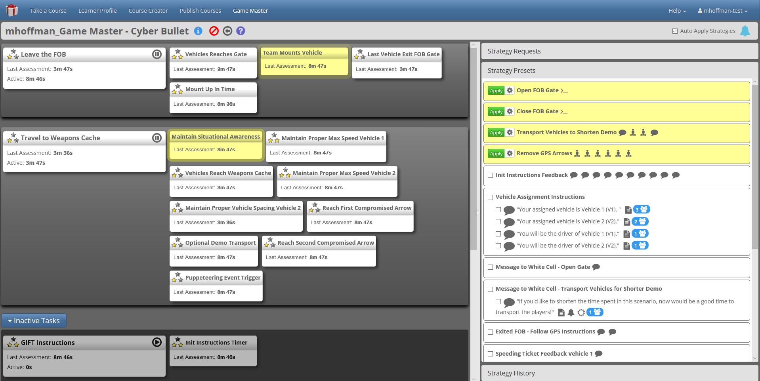
Game master interface (Alpha)

Slide 23
This currently exists…
Demonstration in the domains: (1) Cyber Bullets in Convoy Operation and (2) Clear Building Procedures

Slide 24
Link to Persistent Modeling and Recommendation Engines

Slide 25
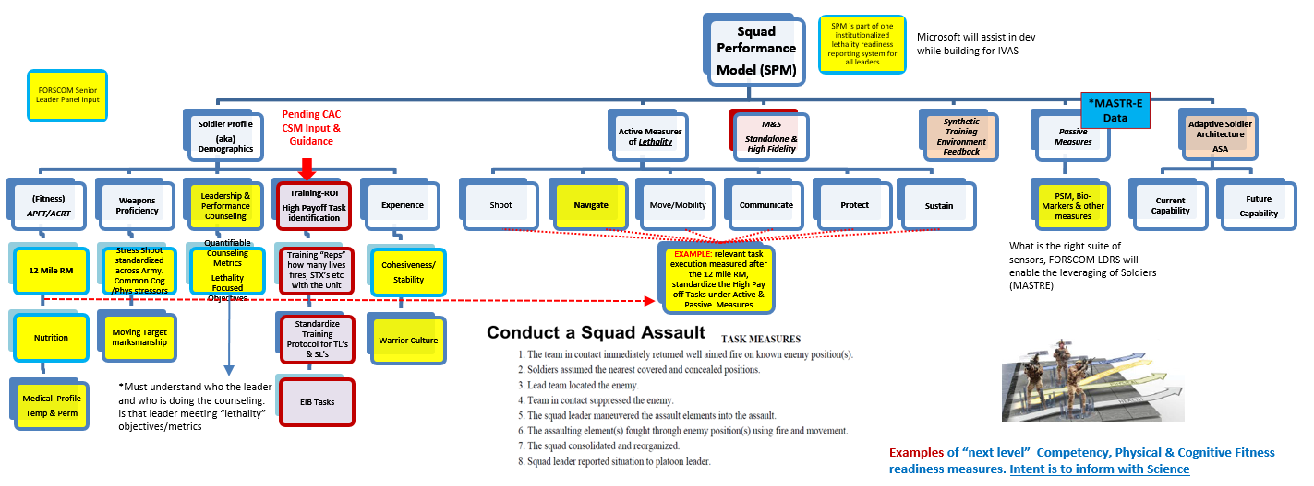
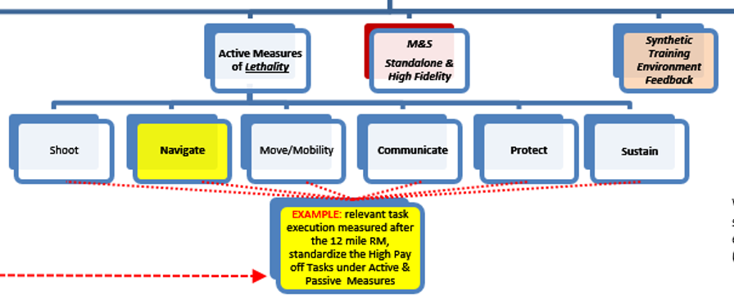
Squad Performance Model: Currently Under Development

Slide 26
CASS Mapping (BTL Level)
Squad
Model
Training Managers create these
(METL tracking?)
CASS Mapping (Unit Level)
Soldier1 Movement Competency
Soldier1 Shooting Competency
Soldier2 Movement Competency
Soldier2 Shooting Competency
Training Managers create these
(METL tracking?)
CASS Mapping
xAPI Data Lake
xAPI
Scenarios create these via GIFT
xAPI specifications
(authored by domain experts…
Represented in GIFT task model)
xAPI
Presence Patrol
xAPI
ROE
Weapon Control
Reporting

Slide 27
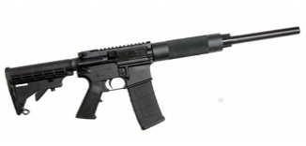
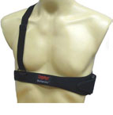
Proposed Architecture
Feedback/Remediation
Learner Record Store
xAPI
SAM T
Total Learning
Architecture
LMS
Weapon
Weapon:
Aim (x,y)
Trigger Squeeze
BioHarness:
Breathing
ECG
Posture
Performance :
Hit/Miss
Casualties
??
Shooter
Shooter
STE TMT (GIFT)
Competency Framework:
SQD Performance Model
Coaching Model
BioHarness Sensor
Team/Trainee Model
Recommender Engine
Universal Trainee Record
Shooter
Shooter
Shooter
Performance
Assessment
Team
Performance
Model
Back-Up Behavior
Models
Raw Data
Expert Marksmen
Models
Team
Coordination
Model
Eye-Tracking
(Nov. 19?)
Eye Tracking:
Gaze/Fixation
Communication:
???
OC Input
8
Notes:
Aim and Trigger Squeeze: 6 Hz Sampling Rate
Breathing Waveform: 18 Hz Sampling Rate
Three metrics are assessed
Trigger Squeeze
Breathing
Barrel Movement
While the shooter is aiming and firing at the target, GIFT receives real time data from EST and BioHarness sensor.
At conclusion of each shot, the raw data signals are analyzed and a single value is computed for each metric.
The computed value for each metric is compared against threshold values derived from statistical analysis of data captured from the shots of expert marksmen. Each metric is assessed as:
Above Expectation
At Expectation
Below Expectation

Slide 28
Thank you ☺
??Questions??

